Slide 1


RECOGNIZING & COMMUNICATING RISK
Lecture 04
Syeda Farwa Rizvi

Slide 2


Contents
Hazards and Risk
Types of hazards
Learning the language of safety: Signs, symbols and labels

Slide 3
Risk
Definitions of risk can be complex.
The Royal Society Study Group report1 offers the following definition:
‘RISK is the probability that a particular adverse event occurs during a stated period of time, or results from a particular challenge’.

Slide 4
Definitions
HAZARD is seen as the situation that in particular circumstances could lead to harm,
HARM is the loss to a human being (or to the human population) consequent on damage
DAMAGE is the loss of inherent quality suffered by an entity (physical or biological).
RISK ASSESSMENT is the general term used to describe the study of decisions subject to uncertain consequences.

Slide 5
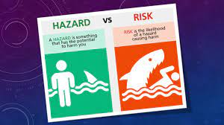

Slide 6
RISK ESTIMATION is the first subdivision of Risk Assessment and includes the identification of outcomes, the estimation of the magnitude of the associated consequences of these outcomes, and the estimation of the probabilities of these outcomes.
RISK EVALUATION is the second subdivision of Risk Assessment and is the complex process of determining the significance or value of the identified hazards and estimated risks those concerned with or affected by the decision.
RISK MANAGEMENT is the making of decisions concerning risks and their subsequent implementation and flows from Risk Estimation and Risk Evaluation.

Slide 7
The Health and Safety Executive 3,4 offer the following definition of hazard and risk:
HAZARD means anything that can cause harm (e.g. chemicals, electricity, working from ladders, etc);
RISK is the chance, high or low, that somebody will be harmed by the hazard.

Slide 8
THE COMPONENTS OF RISK

Slide 9
Hazard
The definition of ‘hazard’ presented above has two elements.
the ability to harm a person.
does not mean that harm will arise – a hazardonly has to have the potential to harm.
Acute hazard --> Suddenly (short term)
Acute hazards appear suddenly, For example, a fall as a result of a downed power line can result in chronic back pain
Chronic hazard -->(long term) e.g smoking
The potential for injury or damage to occur as a result of prolonged exposure to an undesirable condition (e.g., smoking, with the potential for causing lung cancer)

Slide 10
Consequence (natija)
The harm that arises from a hazard is the consequence of it.
It is important to identify the possible consequences before embarking on a hazard control strategy.

Slide 11
Likelihood (amkaan)
An important element of risk is the likelihood or probability that the hazard will cause injury.
In its simplest form, probability can be considered as high, medium or low and for the majority of this risk assessments this should prove adequate.

Slide 12
Perception (khayal/tasur)
Different groups have a different perspective.
people are unable to estimate risk with accuracy and they are biased by media reports
different groups will rank risks differently and ignore expert assessment
people react more to risks that are relatively unknown to them where they feel they have little control over the consequences compared with known risks that kill thousands of people each year, over which they have some control.

Slide 13
Strategies To Control Risk
Risk control hierarchy A risk control hierarchy is a structured approach whereby for each hazard a set of action options is considered.
The action that should be adopted is the one that gives the greatest degree of protection, not only to the operator but also to others who may be exposed to the hazard.

Slide 14
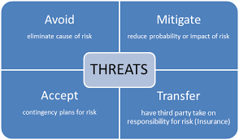

Slide 15
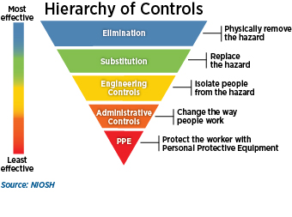
Risk Hierarchy
Elimination
Substitution
Reduction.
Personal protection

Slide 16
Types of Hazards
A common way to classify hazards is by category:
Biological – bacteria, viruses, insects, plants, birds, animals, and humans, etc.,
Chemical – depends on the physical, chemical and toxic properties of the chemical,
Ergonomic – repetitive movements, improper set up of workstation, poor design of equipment, workstation design, (postural) or workflow, manual handling, repetitive movement. etc.,
Physical – Slippery floors, objects in walkways, unsafe or misused machinery, excessive noise, poor lighting, fire. radiation, magnetic fields, pressure extremes (high pressure or vacuum), noise, etc.,
Psychological – Shift work, workload, dealing with the public, harassment, discrimination, threat of danger, constant low-level noise, stress, violence, etc.,
Safety – slipping/tripping hazards, inappropriate machine guarding, equipment malfunctions or breakdowns

Slide 17
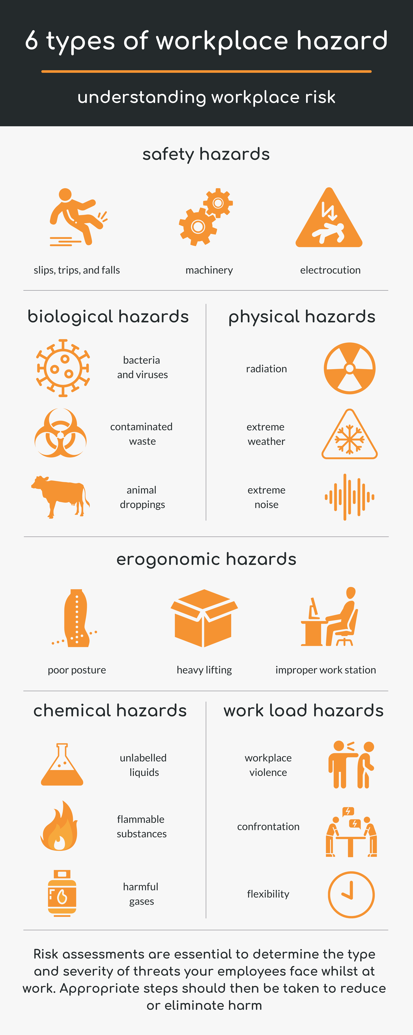

Slide 18
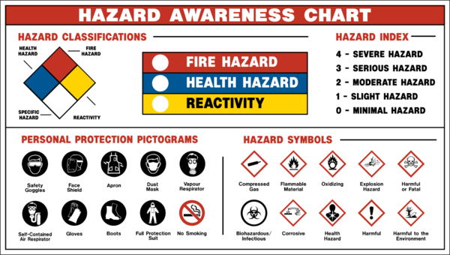

Slide 19
